Slide 1
F & D Projects
Submitted BY :-SHRUTI
GROUP :- 17 (2010992097) CSE
Email:-shruti2097.be20@chitkara.edu.in
Submitted to:- MR. LAVISH ARORA

Slide 2
PROJECT 1:- ELECTROSHOW -(commercial based website)
PROJECT 2:-NEO- BAGS THAT SPEAKS FOR YOU -(handbags website)

Slide 3
Home Page
Website Name-ElectroShow
It includes Navigation bar on which buttons to demo page,login and sign up page are there.
Search bar to search items.
Linear gradient CSS property on hovering is used
on Login an SignUp buttons.

Slide 4
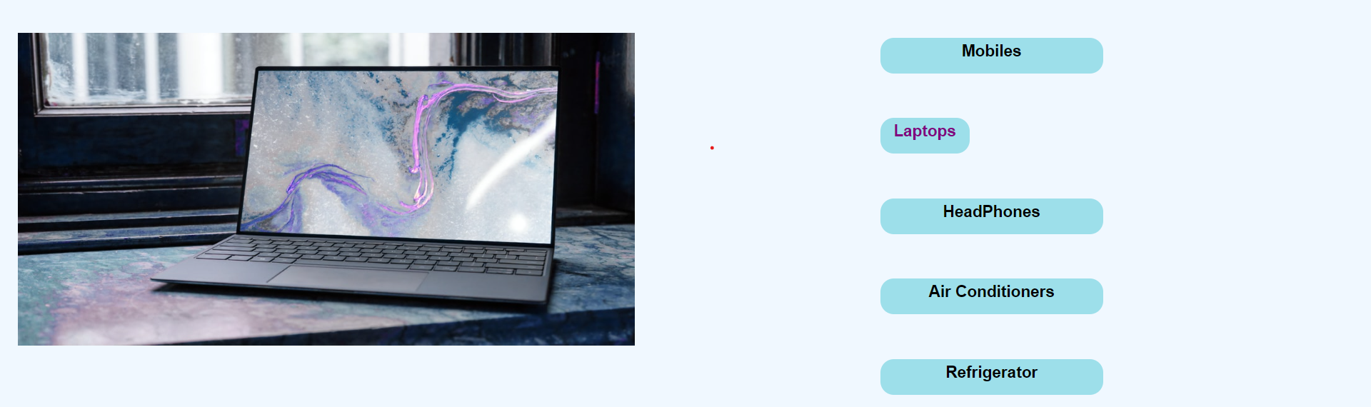
Slideshow & Category
Buttons of different category are made using css property and transition property is used on them. On hovering width decreases to 100px.
To make slideshow @keyframes is used to specify the animation code i.e. by writing down the direction in which images has to move either left or right.

Slide 5
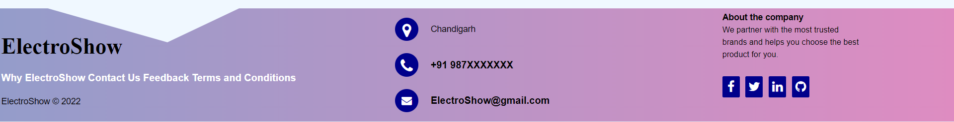
Footer
It contains the information about the website,feedback form, contact us and our other social media handles.
Clip path css property is used to give the design as it creates a clipping region that sets what part of an element should be shown.
It was Divided into 3 divs i.e. footer-left,footer-center,footer-right to align the items used.

Slide 6
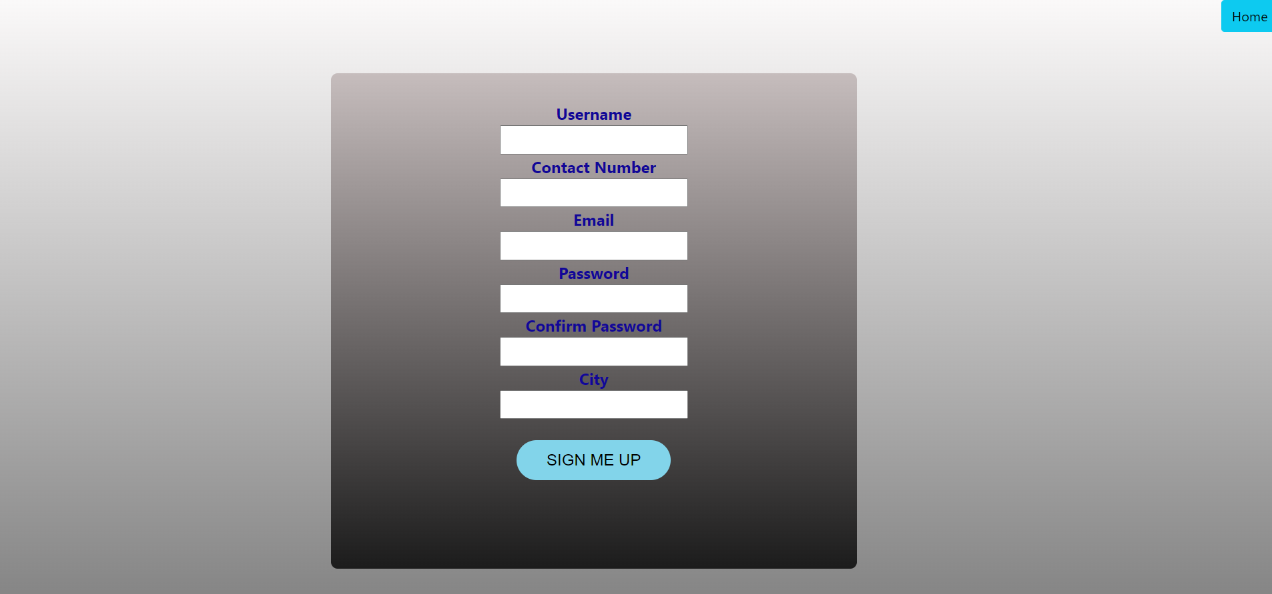
SignUp Page
Sign up page is made for new users. Using bootstrap property home button is given on top-right side.
In background linear gradient is used to give the blur effect.
Syntax: background: lineargradient(direction, color-stop1, color-stop2, ...);

Slide 7
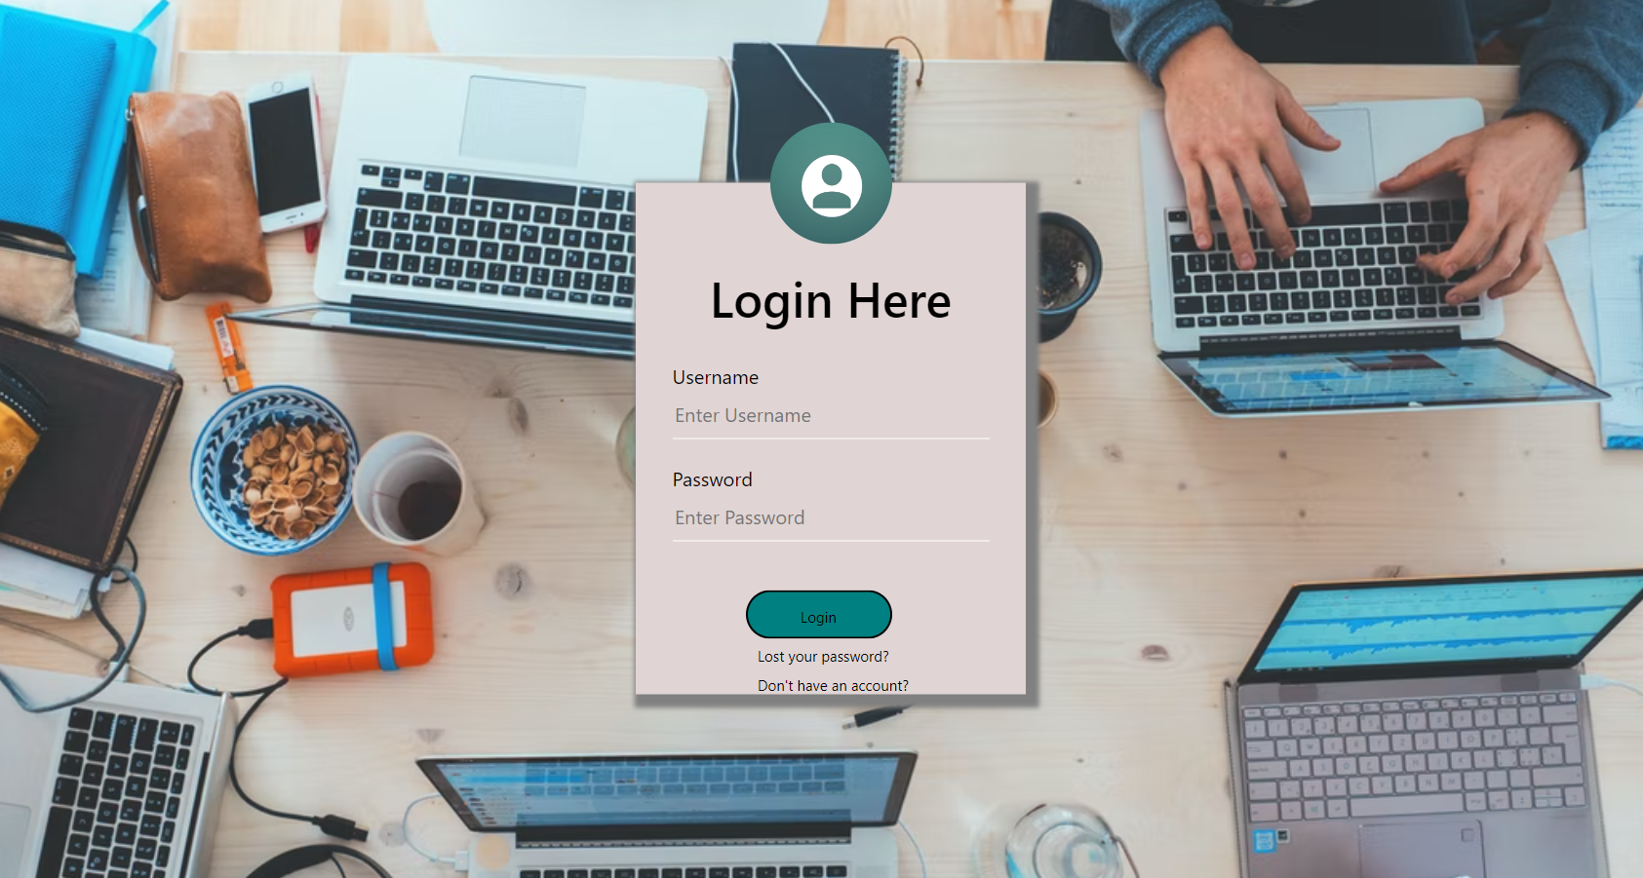
Login Page
Background image is added
transform: translate(value,value) is used to specify the position of the login box in the center.
Box-shadow css property is used to given shadow on sides of login box.

Slide 8
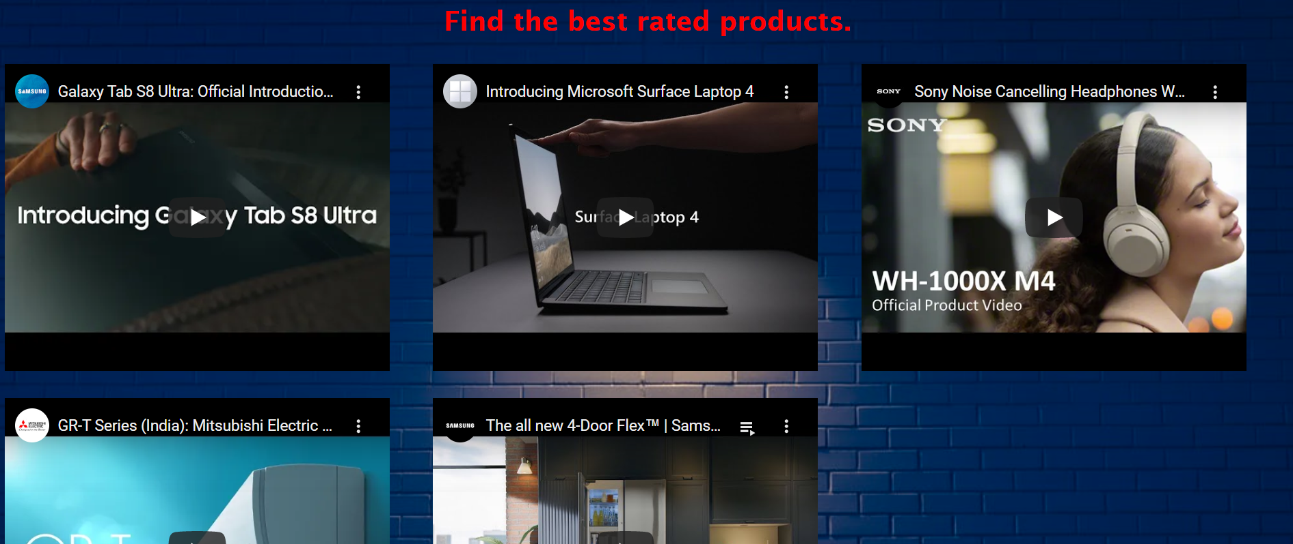
Demo page
Videos are embedded to help user to find the latest and best rated products.

Slide 9
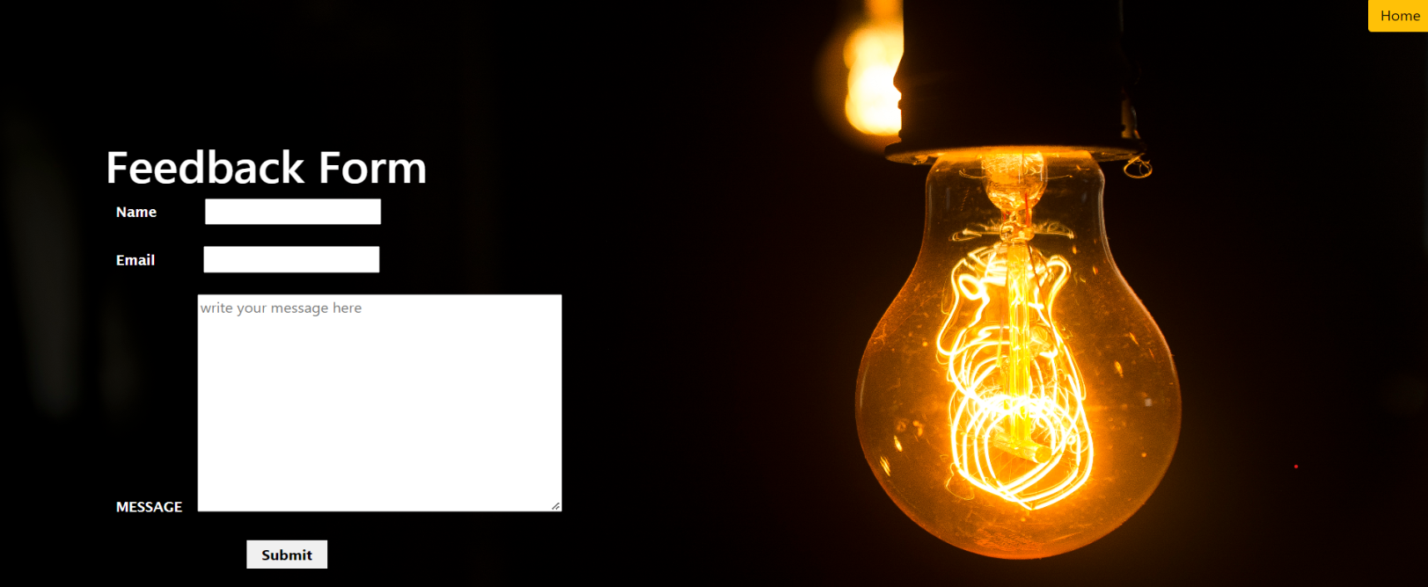
Feedback form
Feedback form is provided to collect opinions on services provided any if they faced any issue .
Home button is set using bootstrap.
Background image is set using background properties like background-image,position,size,repeat.

Slide 10
Thank you

